Slide 1

NYSE Stock Valuation Multiples Analysis
Comprehensive analysis of NYSE stock valuation using P/E, P/B, and other multiples across three industries: Metal & Mining, Consumer Staples, Utilities.
AI-Generated Presentation • Confidential

Slide 2
Executive Summary
1
2
3
4
5
Market Trends
Sector Performance
Key Findings
Growth Metrics
Valuation Multiples
NYSE stock valuation multiples analysis from 2022 to 2025
Metal & Mining, Consumer Staples, and Utilities sectors analyzed
Distinct sector patterns amid volatility, macroeconomic shifts, and trends
Strong 2025 rebounds in Metal & Mining, steady growth in Consumer Staples
P/E, P/B, EV/EBITDA, P/S, PEG, and EV/Sales multiples analyzed
2

Slide 3
Background
1
NYSE stock valuation multiples analysis is crucial for investors and analysts
Introduction to NYSE Stock Valuation Multiples Analysis
Objective
2
To analyze valuation multiples across three industries: Metal & Mining, Consumer Staples, and Utilities
Methodology
3
Using historical data from 2022 to 2025, including P/E, P/B, EV/EBITDA, P/S, PEG, and EV/Sales multiples
Scope
4
The analysis covers the NYSE-listed stocks in the three selected industries
Importance
5
Understanding valuation multiples is essential for making informed investment decisions
3

Slide 4
Key Statistics
P/E RATIO
EV/EBITDA
GROWTH RATE
VALUATION MULTIPLE
16.3x for Newmont, 11.3x for Procter & Gamble
9.3x for Newmont, 7.3x for Duke Energy
176.8% for Newmont, 8% for Consumer Staples sector
21.6x for Consumer Staples sector, 10x for Utilities sector
4

Slide 5
Metal & Mining vs Consumer Staples
METAL & MINING
CONSUMER STAPLES
High Volatility: Metal & Mining sector experienced high share price volatility
Reliable Earnings: Consumer Staples sector had reliable earnings amid inflation
Steady Growth: Consumer Staples sector exhibited steady growth and defensive stability
Growth Metrics: Metal & Mining sector had spiked growth metrics during optimism
Low Valuation: Metal & Mining sector had low valuation multiples due to commodity cycles
Consistent Gains: Consumer Staples sector had consistent gains, e.g., Procter & Gamble
5

Slide 6
Valuation Multiples for Freeport-McMoRan and Newmont
COMPANY
P/E (TTM)
P/B
EV/EBITDA
Freeport‑McMoRan
34.6x
2.32x
40.1x
Newmont
16.3x
3.28x
9.3x
2 records · 4 metrics · Source: Document Analysis
6

Slide 7
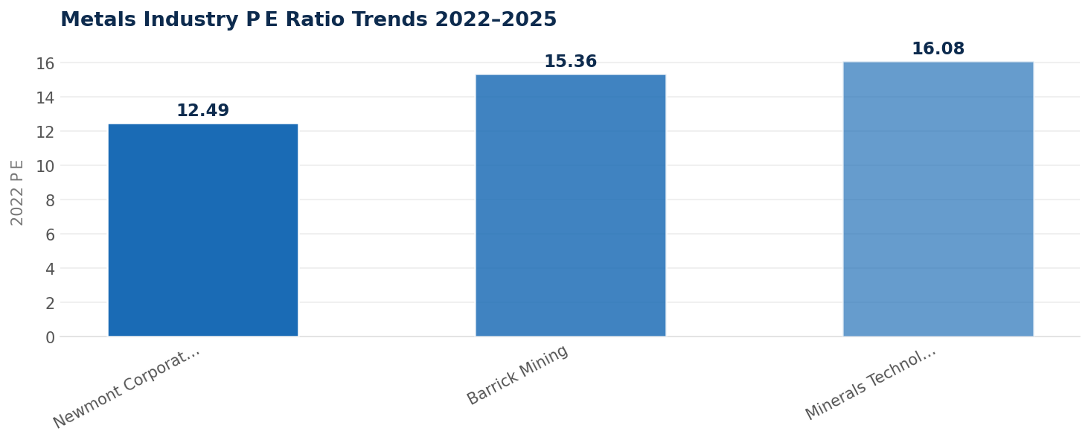
Metals Industry P/E Ratio Trends
Data visualization from document analysis
📊
7

Slide 8

Mixed Performance
1
Utilities sector displayed mixed performance
Utilities Sector Overview
Lower Valuation
2
Utilities sector had lower valuation multiples
Capital Expenditure
3
Utilities sector had significant capital expenditure growth
Growth Metrics
4
Utilities sector had moderate growth metrics
Key Players
5
Duke Energy and NextEra Energy were key players in the sector
8

Slide 9
Key Factors in NYSE Stock Valuation
01
02
03
04
Valuation Multiples
Growth Metrics
Industry Trends
Company Performance
P/E, P/B, EV/EBITDA, P/S, PEG, and EV/Sales multiples
Revenue growth, earnings growth, and dividend growth
Macroeconomic shifts, trends like ESG, energy transition, and AI
Financial performance, management team, and competitive advantage
9

Slide 10
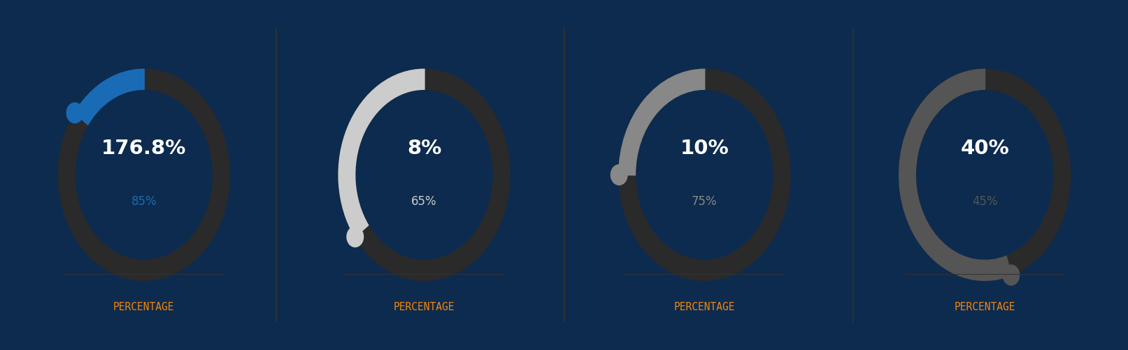
Key Valuation Multiples
10

Slide 11
NYSE Stock Valuation Insights
The NYSE stock valuation multiples analysis reveals distinct sector patterns
Growth Metrics: 176.8%
Valuation Multiple: 21.6x
P/E Ratio: 16.3x
11

Slide 12

Conclusion
→
NYSE stock valuation multiples analysis is crucial for investors and analysts
→
Distinct sector patterns were observed, with Metal & Mining experiencing high volatility
→
Consumer Staples sector exhibited steady growth and defensive stability
→
Utilities sector displayed mixed performance, with lower valuation multiples
→
Understanding valuation multiples is essential for making informed investment decisions
12

Slide 13
Final Thoughts
→
Investment Decisions: Understanding valuation multiples is essential for making informed investment decisions
→
Sector Performance: Each sector has its unique characteristics and trends
→
Growth Opportunities: Identifying growth opportunities is crucial for long-term success
→
Risk Management: Managing risk is essential in today's volatile market
→
Continuous Monitoring: Continuous monitoring of the market and sector trends is necessary
13

